Slide 1

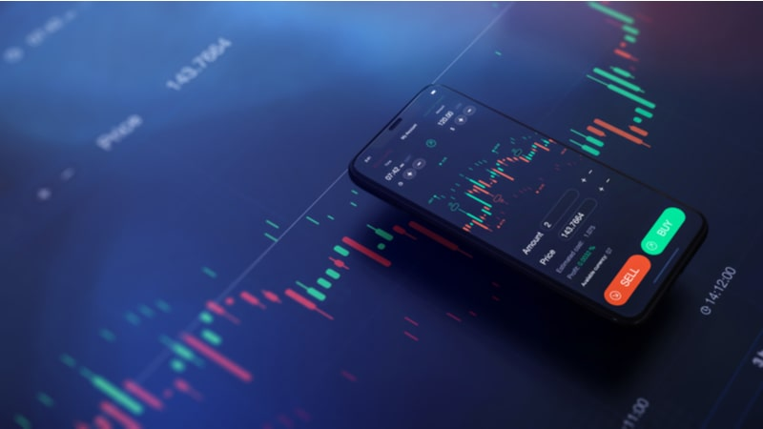
Your Money Matters
Investify
By ACETraders
Trade, one size fits all.

Slide 2
What exactly is trading, investment?
Why people fear trading?
Risk per Day analysis
What we plan?
Conclusion
In this Presentation
Here's what we'll cover:

Slide 3
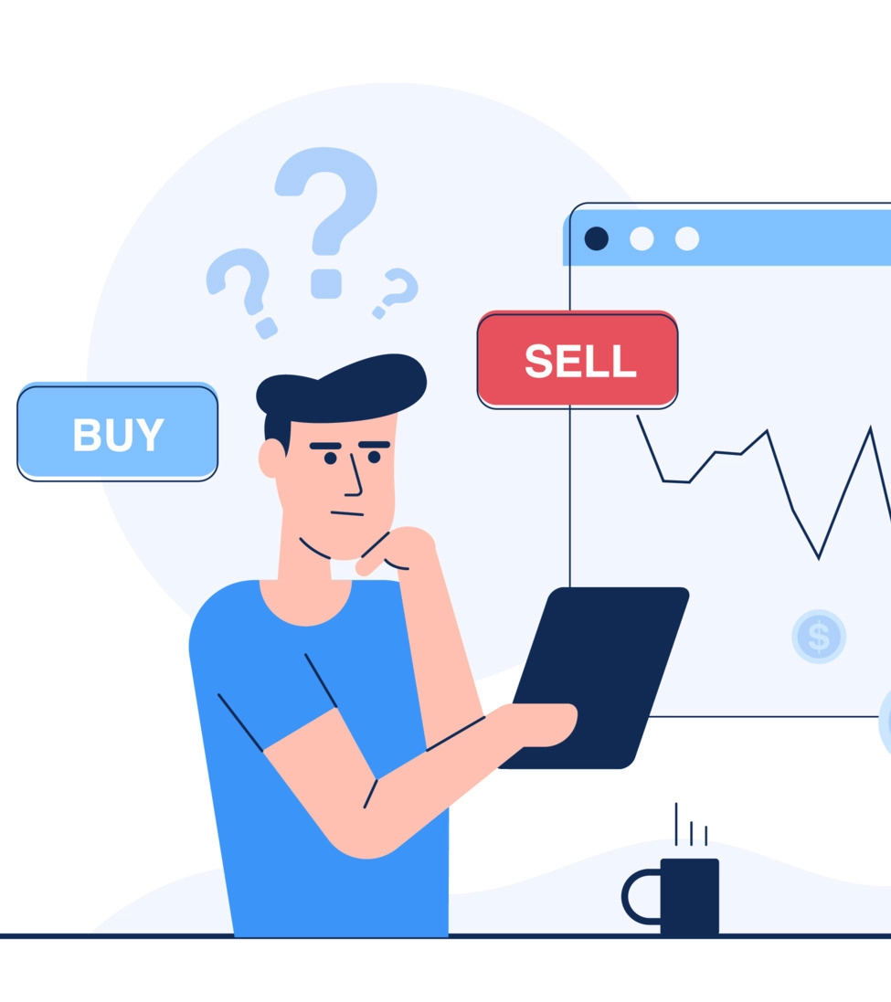
What is Trading?
Trading refers to the buying and selling of financial instruments such as stocks, bonds, currencies, commodities, etc. in order to make a profit.
Options trading is a type of financial trading where a buyer has the right but not the obligation to buy or sell an underlying asset, such as a stock or commodity, at a specified price within a specified time period. The buyer of an option pays a premium for this right.

Slide 4
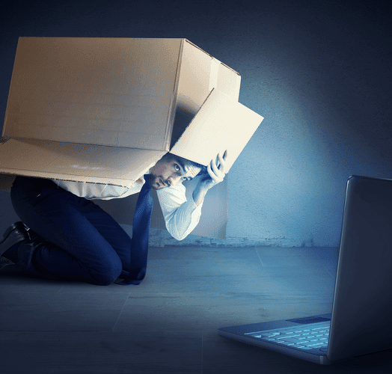
Why do people fear trading?
Lack of knowledge
Risk
Volatility
Emotional involvement
Past experiences

Slide 5
According to various surveys by companies like PayTM DRHP, in India there are only 3-4% people involved in trading
60
40
20
0
USA
UK
CHINA
INDIA

Slide 6
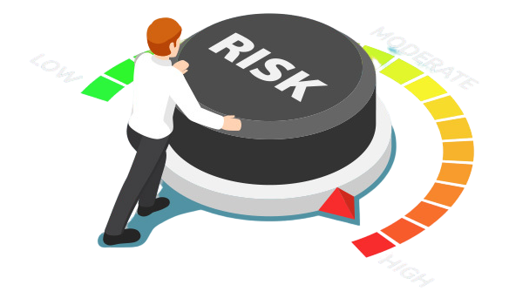
Risk per Day
Risk per day analysis in trading refers to the process of calculating and analyzing the amount of risk an individual trader or portfolio is exposed to on a daily basis.
Risk per day analysis is important in trading because it helps traders control their exposure to risk and ensure that they are not taking on too much risk relative to their account size and risk tolerance.

Slide 7



What we plan?
To give customers a range of options for where to invest their money, we intend to collaborate with a number of banks and brokers that are registered with the NSE. To assist people in making better decisions, we will also provide a numerical representation of the sources' past profits.
Finally, we'll give users the option to select the amount they want to trade with, and we'll let them use the help graphs and net P&L figures to see what happens to their money in real time.

Slide 8


Know where does your money go
Customers' money will be handled by professionals from various sources chosen by the consumer, allowing them to learn in real time while still generating some gains or losses. With the aid of our application, we hope to spread awareness of the value of trade in people.

Slide 9

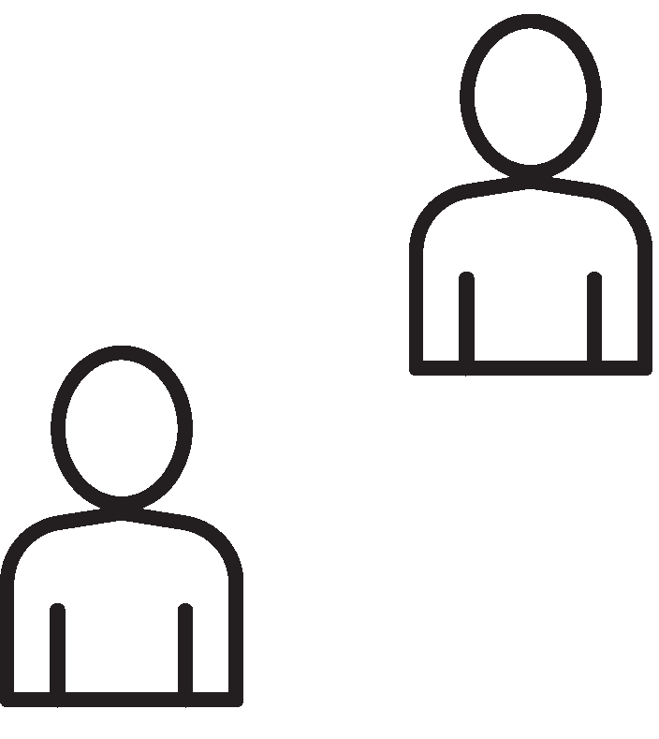

How we want to help the community
How it's impacting in a big way.
Easy tracking |  | Options Trading |  | Risk per Day calculation
Customers can monitor their money, which is handled by experts, through a secure website. |  | Options are thought of as one of the riskiest investments and hardest to master, and they cannot be done through SIP plans offered by various Indian banks. We want to assist customers and do our due diligence. |  | We will assist consumers in calculating their risk each day, enabling those with less or no information to decide if they should invest on that particular day.

Slide 10


Technology has revolutionized personal finance, giving individuals more ease and control over their money.
What to know as a
beginner investor?
Will also be added to the website to help consumers understand some critical factors before investing their money.

Slide 11
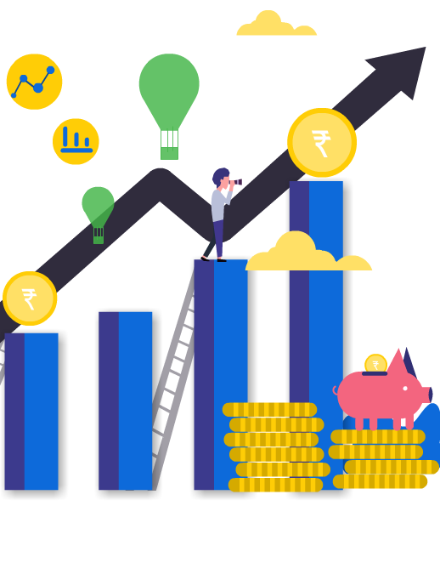
Why we feel trading is important?
Trading is important because it allows individuals and organizations to manage risk, earn a return on their investments, and allocate capital efficiently. Trading can also help to facilitate price discovery and provide liquidity to financial markets, which helps to ensure that assets are priced fairly and can be bought and sold easily. By enabling the exchange of goods, services, and financial assets, trading plays a vital role in the functioning of economies and helps to drive economic growth.

Slide 12
"The advance of technology is based on making it fit in so that you don't really even notice it, so it's part of everyday life.”
Bill Gates

Slide 13
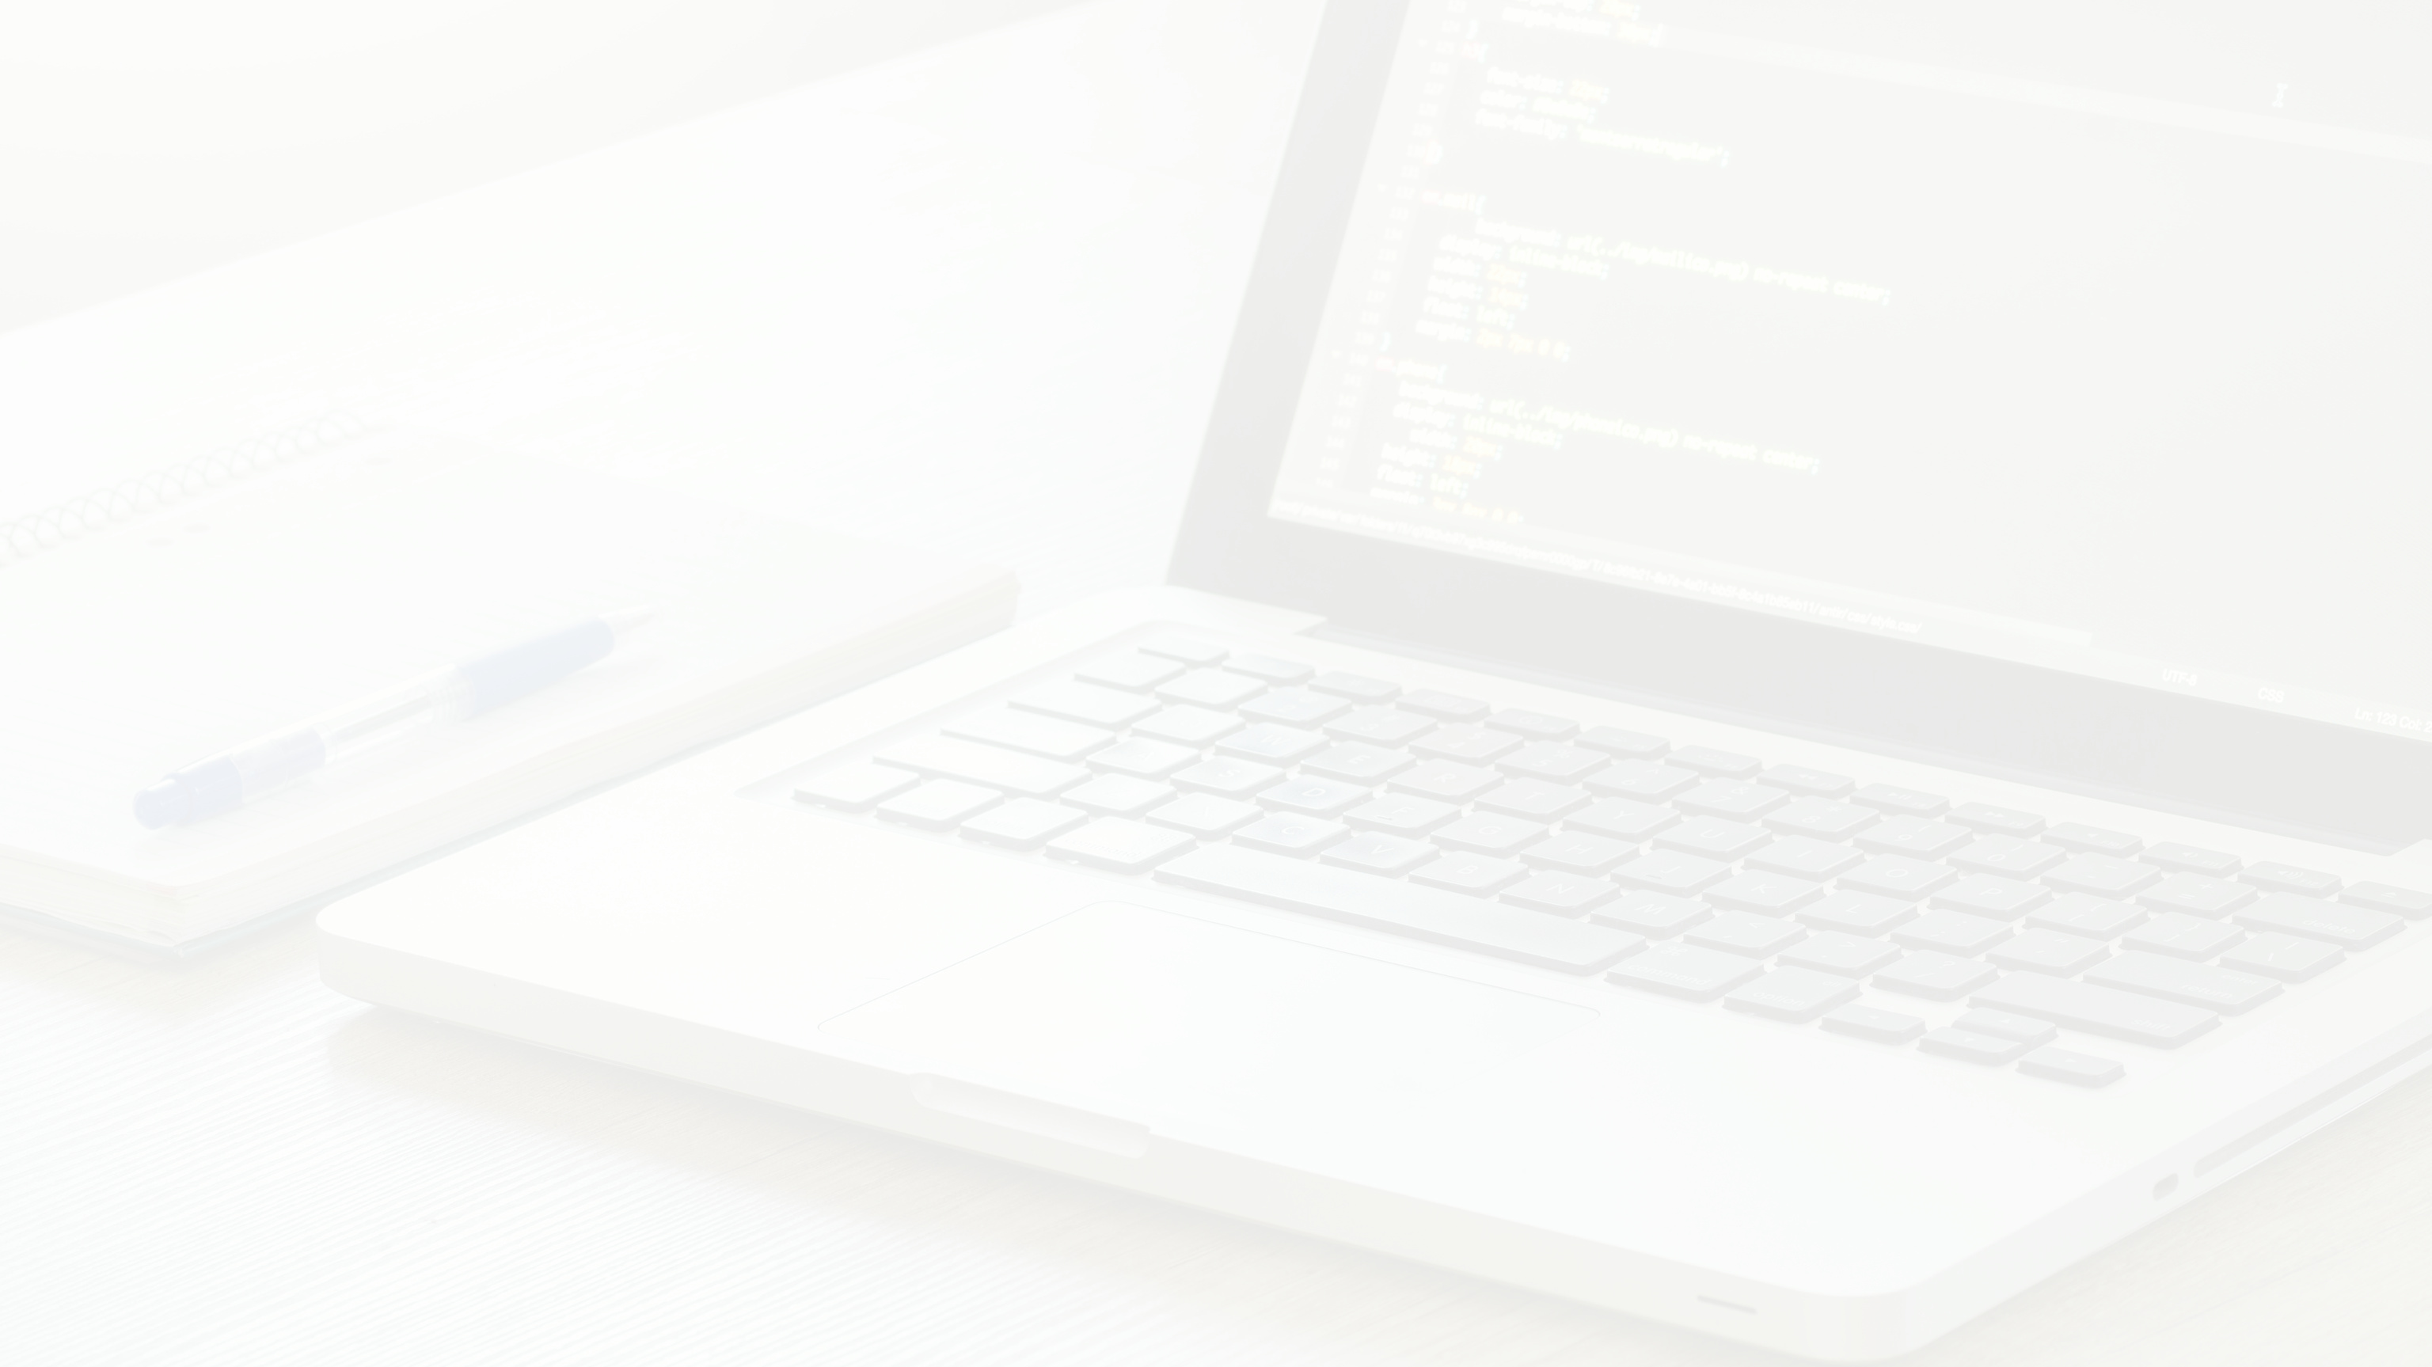


THANK YOU
WWW.REALLYGREATSITE.COM

